Slide 1
Profit Prediction Model – Testing on New Data
Homework 2 · Jakub Wojciechowski · Kozminski University

Slide 2
How the model works
1. Data
5,670 rows
2. Features (X)
Sales, Units Sold, Discount (%), Customer Rating
3. Target (y)
Profit
4. Split
Train 4,536 · Validation 567 · Test 567
5. Scaling
StandardScaler (mean 0, std 1)
6. Model
Linear Regression, 3-fold cross-validation
The trained model and scaler are saved (profit_prediction_model.pkl, feature_scaler.pkl) and then loaded to test them on new data.
Task: (1) test the model on the teacher's experimental data, (2) create my own experimental data similar to the training data and test the model on it.

Slide 3
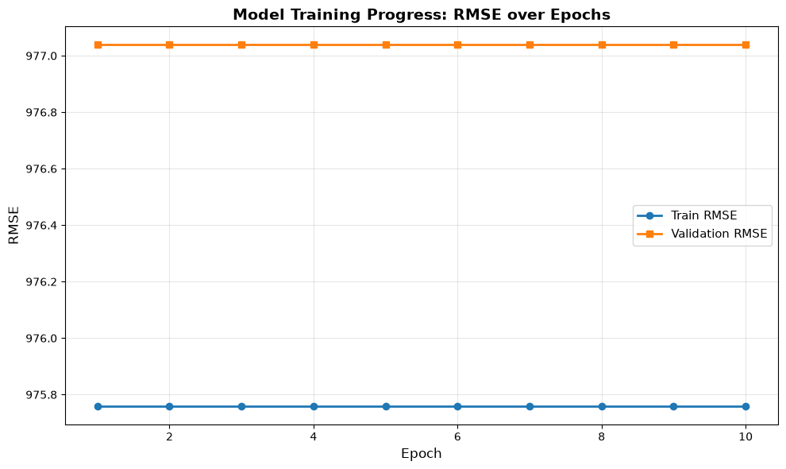
Training data and training progress
The model is not trained on e_commerce_store.csv. The notebook replaces it with synthetic data: 670 generated rows + 5,000 rows generated from their mean and std.
In this data Profit = 0.3 × Sales + random noise.
Cross-validation RMSE is the same in all 10 epochs (train folds 975.76, validation folds 977.04), because linear regression always gives the same result on the same data.

Slide 4
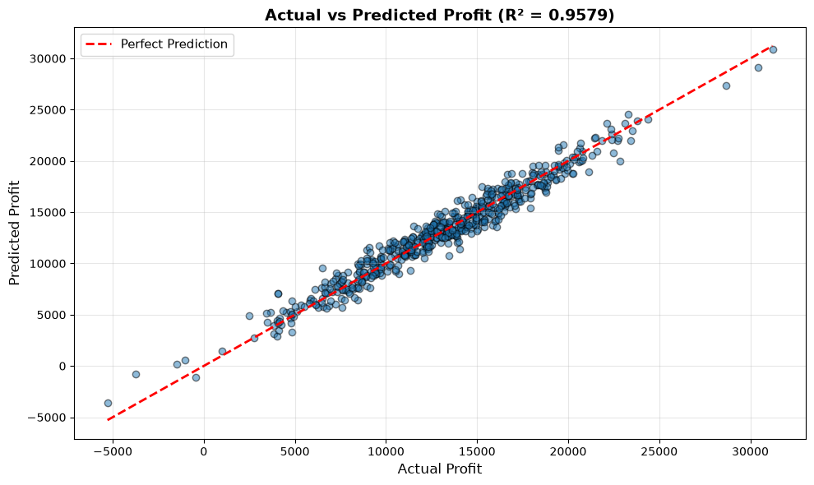
Model performance on validation and test sets
Set | RMSE | MAE | R² | MAPE
Validation | 993.22 | 796.92 | 0.958 | –
Test | 1,024.87 | 823.45 | 0.950 | 7.43%
The model explains about 95% of the variation in Profit (R² 0.950 on the test set).
Validation and test results are almost the same – no overfitting.

Slide 5
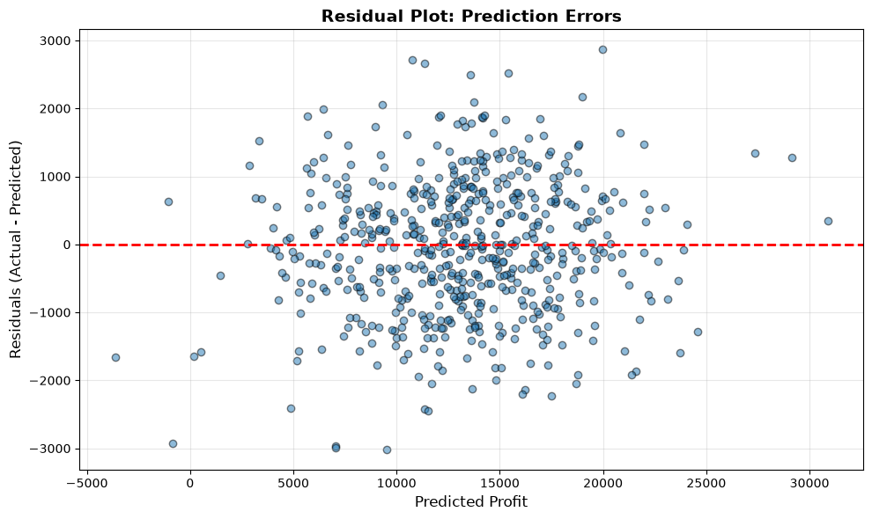
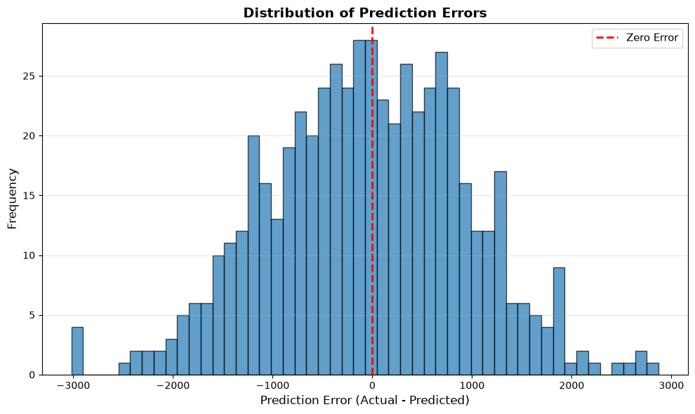
Prediction errors on the validation set
The errors are spread randomly around 0 and have a bell-shaped distribution – the model has no systematic error.

Slide 6
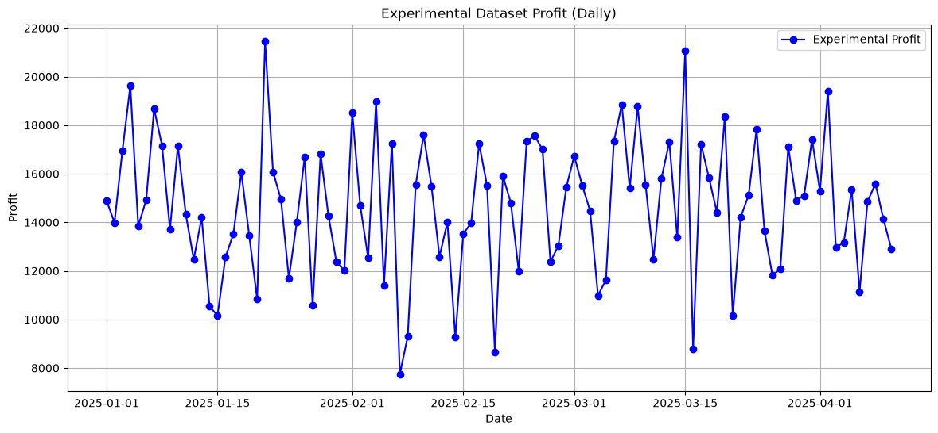
Teacher's experimental data (100 days)
1,069.50
RMSE
864.85
MAE
0.851
The error is almost the same as on the test set (RMSE 1,069.50 vs 1,024.87), so the model works well on this data.
R²

Slide 7
Teacher's data vs model data
Variable | Model data mean | Teacher mean | Model data std | Teacher std
Sales | 44,583.76 | 48,961.53 | 15,117.84 | 9,081.68
Units Sold | 348.27 | 351.78 | 96.31 | 76.29
Discount (%) | 15.62 | 15.32 | 8.03 | 5.42
Customer Rating | 4.09 | 4.15 | 0.78 | 0.44
Profit | 13,375.51 | 14,632.46 | 4,670.11 | 2,786.59
The means are fairly close, but the teacher's data has a smaller spread (e.g. Sales std 9,081.68 vs 15,117.84).
R² is lower (0.851 vs 0.950) only because Profit varies less here, so the same error is a bigger part of the variation.

Slide 8
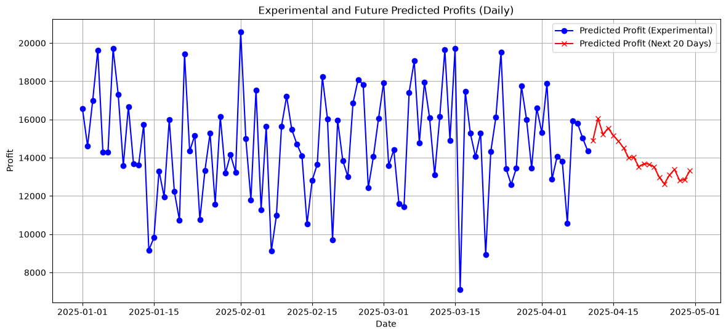
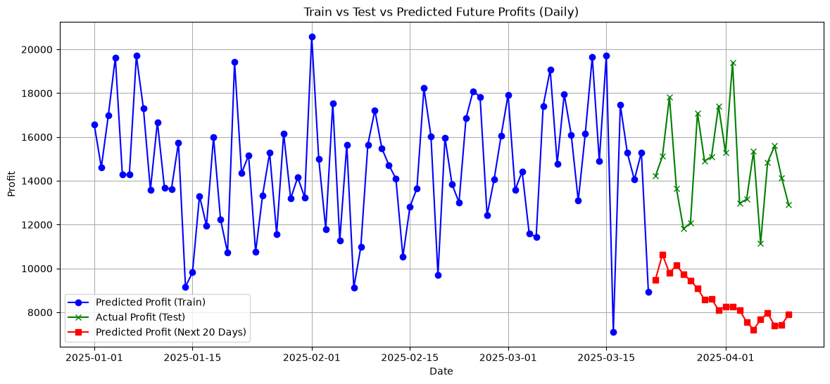
Future 20 days – predictions cannot be checked
Both charts predict the next 20 days from simulated features (random changes from the last day), not real data. Left: there is no real profit for these days, so they cannot be checked. Right: the dates are the same as the test set, but the features are simulated, so the predictions cannot be compared fairly. They start from the last training day (a low day, about 9,000) and go down, while the real test profits stay between about 11,000 and 19,000.

Slide 9
My experimental data
How it was created
200 rows, random seed 2024
Each feature: normal distribution with the same mean and std as the model data
Profit = 0.3 × Sales + noise (same rule as the model data)
Variable | Model mean | My mean | Model std | My std
Sales | 44,583.76 | 45,448.60 | 15,117.84 | 15,344.73
Units Sold | 348.27 | 335.44 | 96.31 | 101.85
Discount (%) | 15.62 | 16.18 | 8.03 | 8.51
Customer Rating | 4.09 | 4.10 | 0.78 | 0.79
Profit | 13,375.51 | 13,755.56 | 4,670.11 | 4,578.46
The means and spreads of my data are very close to the model data.

Slide 10
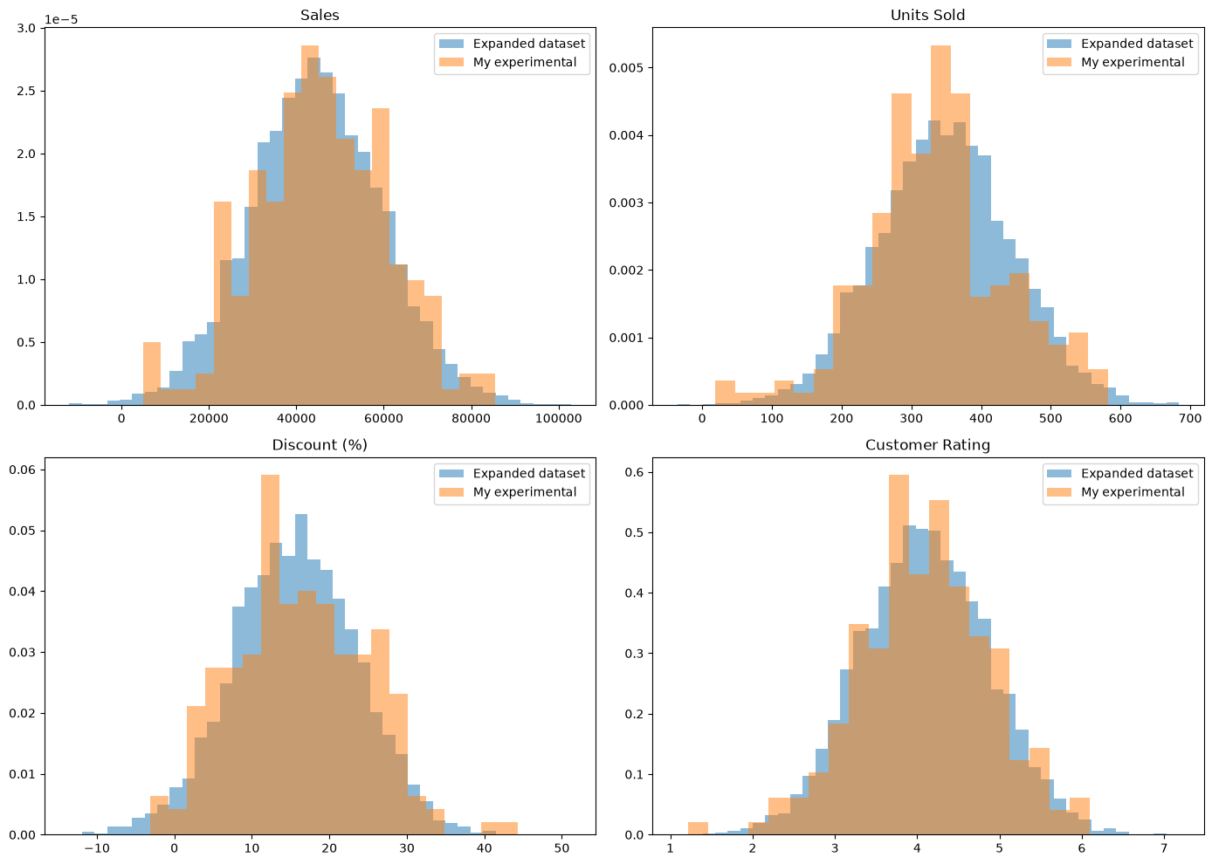
Is my data similar to the model data?
Feature | KS p-value
Sales | 0.668
Units Sold | 0.032
Discount (%) | 0.365
Customer Rating | 0.858
The histograms overlap well.
Kolmogorov-Smirnov test: p > 0.05 for Sales, Discount and Rating – no difference.
Units Sold p = 0.032 is a random result: the data comes from the same distribution, and with 4 tests one value below 0.05 can happen by chance.

Slide 11
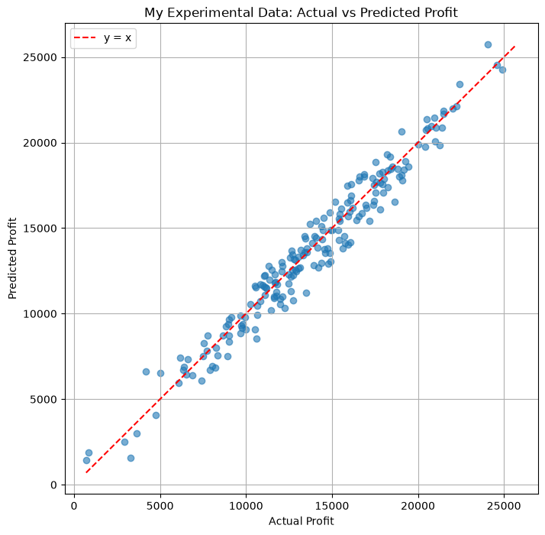
Model performance on my data
929.95
RMSE
756.75
MAE
0.959
R²
As good as on the test set.

Slide 12
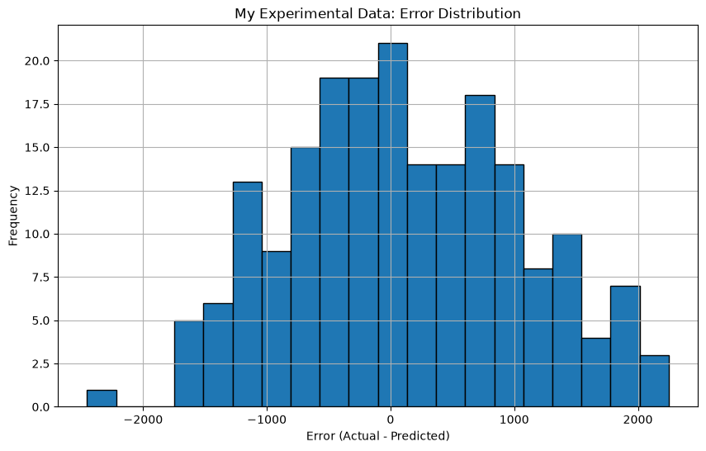
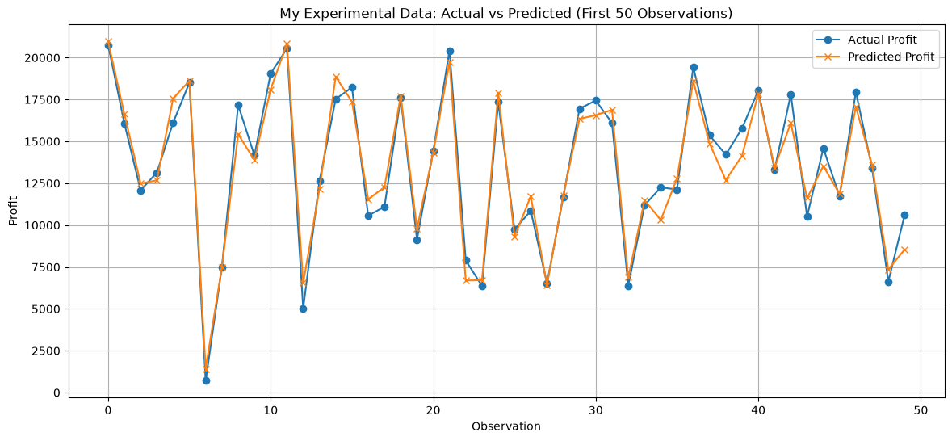
Errors on my data
The errors are centred around 0, and the first 50 predictions follow the real values closely.

Slide 13
Summary and conclusion
Data | RMSE | MAE | R²
Validation set | 993.22 | 796.92 | 0.958
Test set | 1,024.87 | 823.45 | 0.950
Teacher's experimental data | 1,069.50 | 864.85 | 0.851
My experimental data | 929.95 | 756.75 | 0.959
The model works well on new data when the data is similar to the training data.
On my data the error is as low as on the test set (R² 0.959).
On the teacher's data the error is similar; R² is lower only because the data has a smaller spread.
If new data were very different from the training data (like trucks instead of cars), we could not expect the same results.

